Slide 1
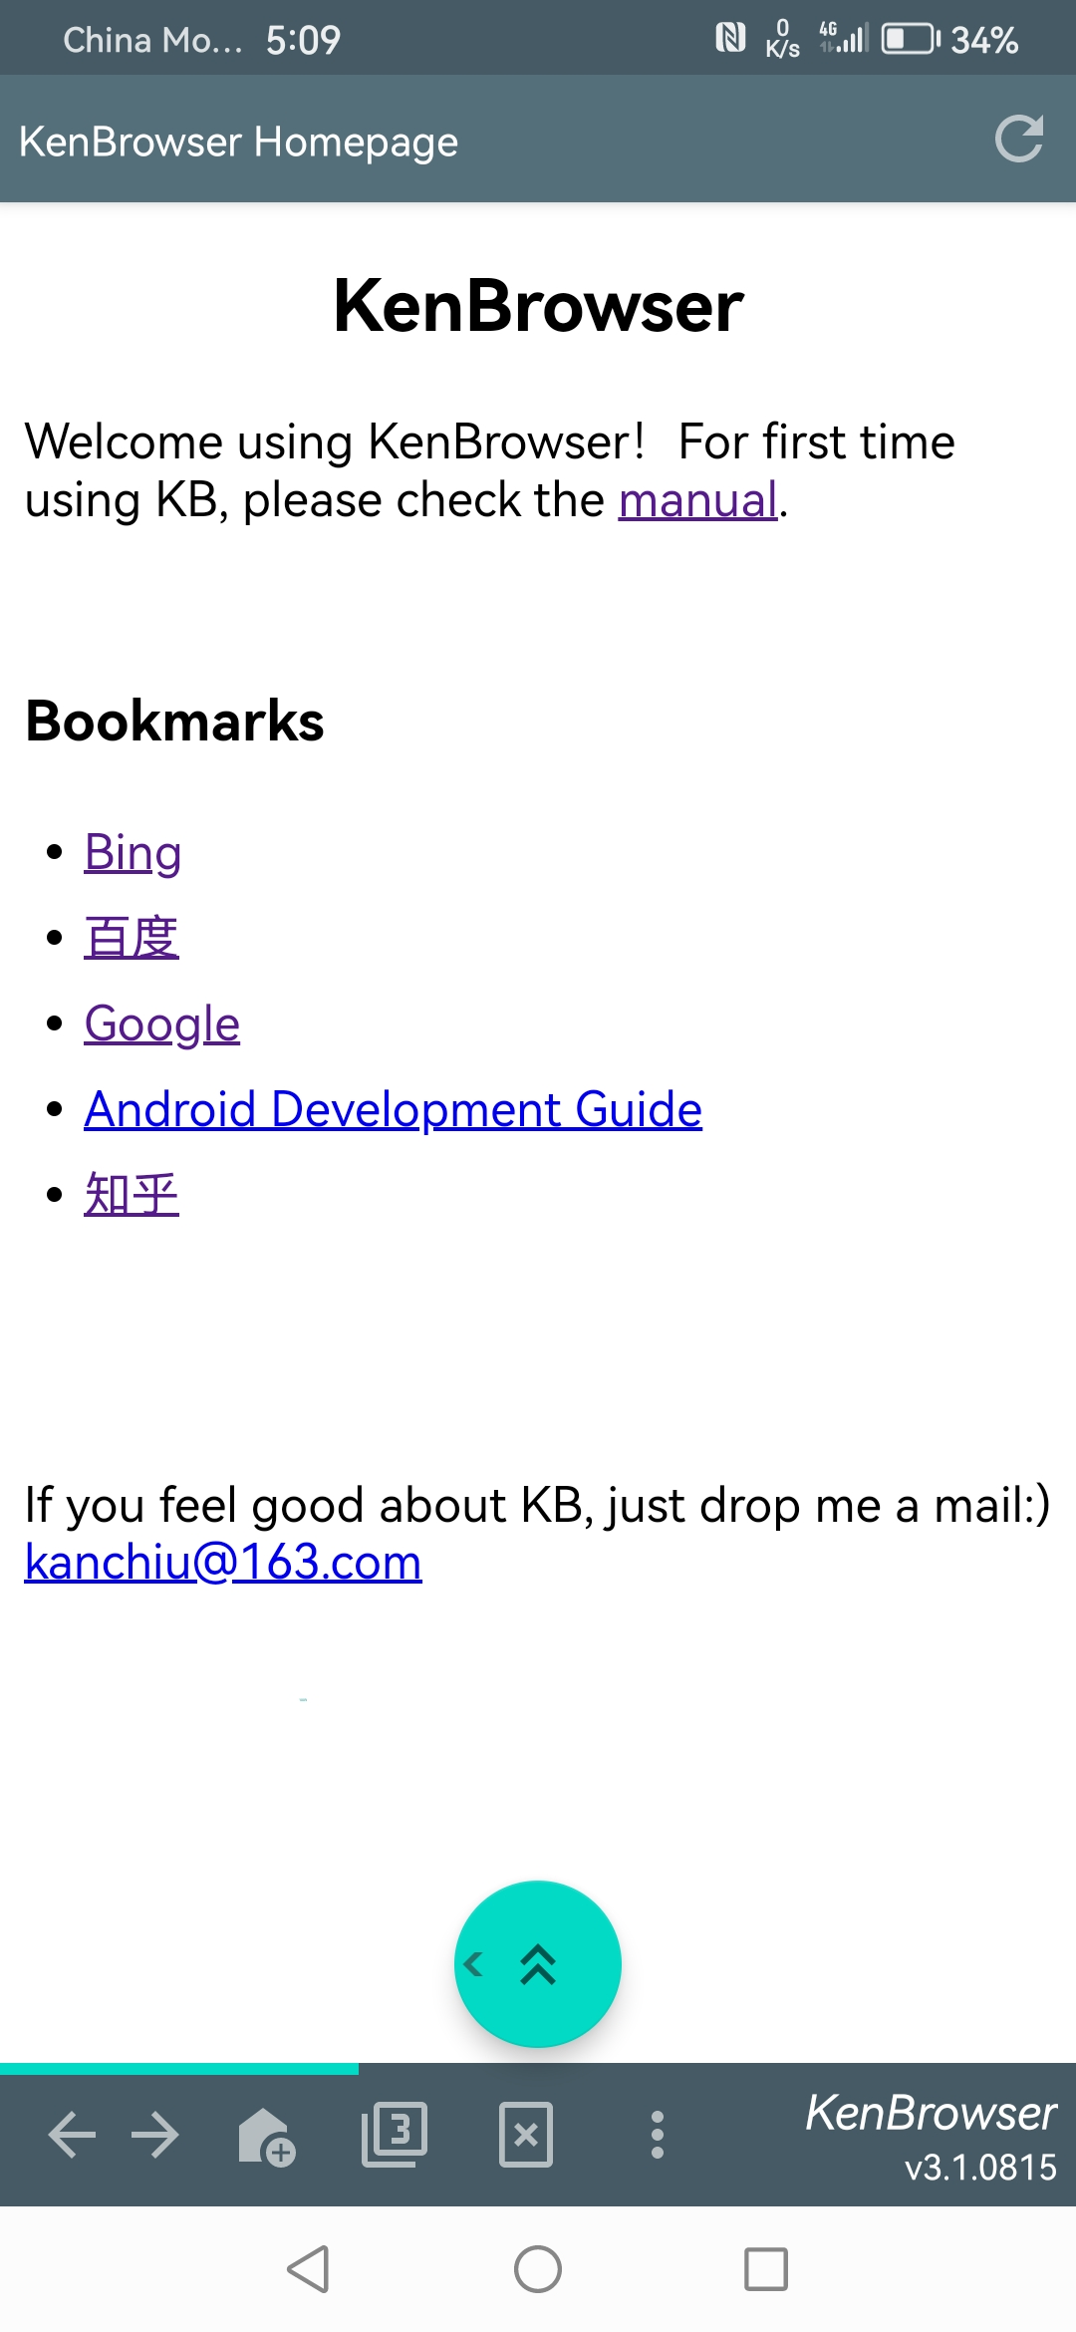
Tiny and clean
App small as 4m size
No ad and unnecessary functions

Slide 2
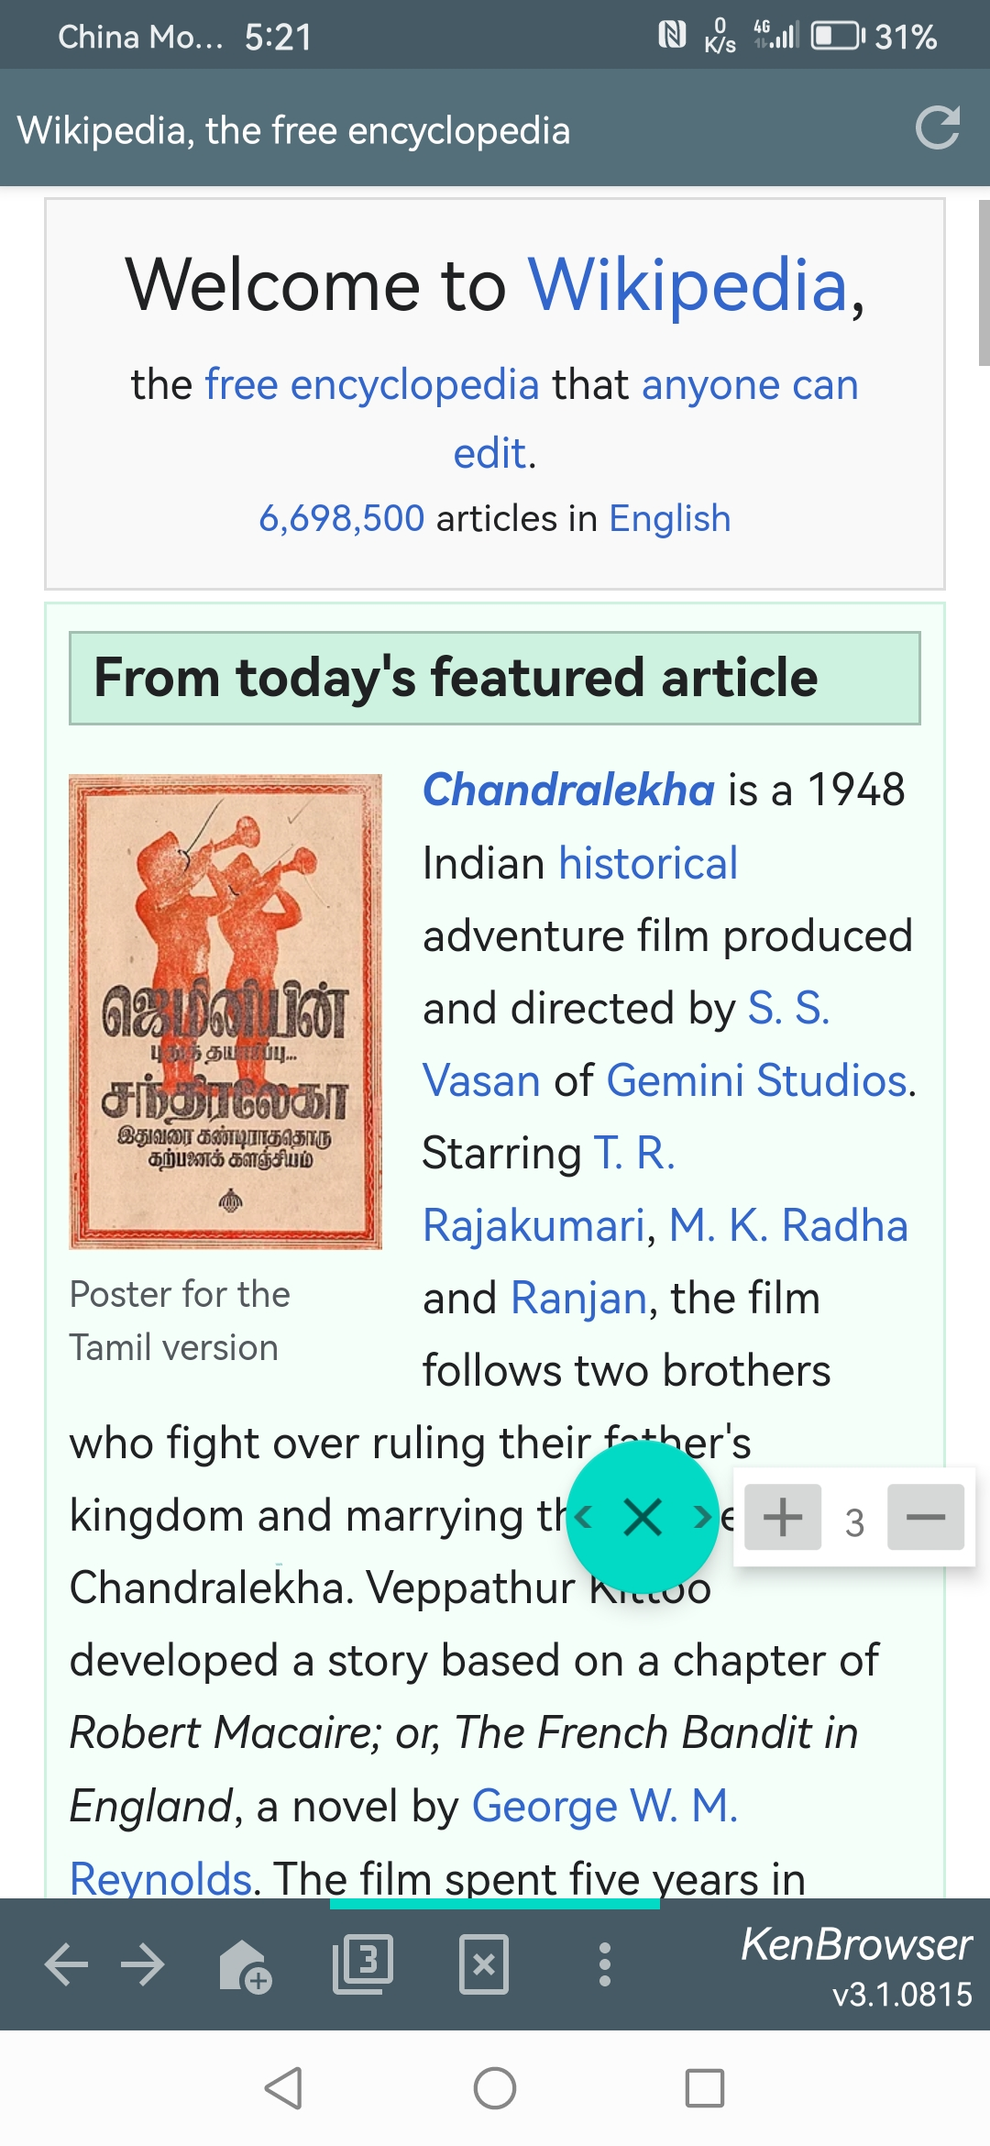

Floating Button
Scroll up/down, swipe left/right
Auto-scrolling with speed control
Page browsing with only one finger
Floating button:
Click: scroll up
Double-click: auto-scroll
Long-click: drag & move
Swipe-out: swipe page
Touch & swipe out of the button boundary, trigger page swipe.

Slide 3
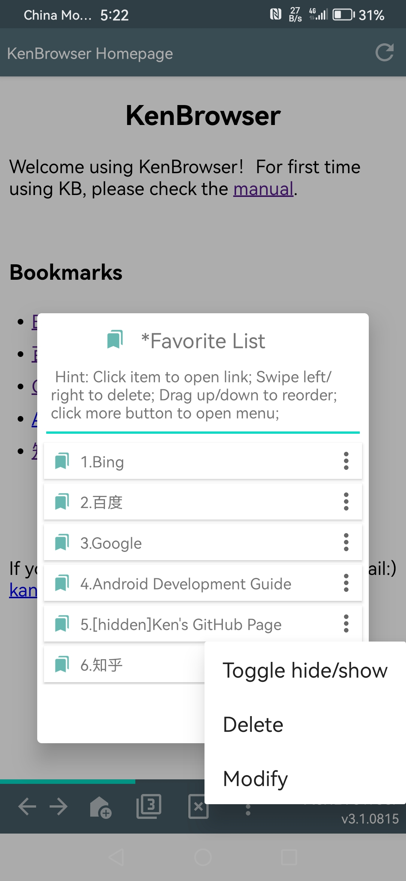
Hidden Bookmarks
Toggle hide/show your private bookmarks
Double-click the title to show hidden bookmarks
双击显示隐藏的书签
When showing hidden bookmarks, click to toggle status

Slide 4
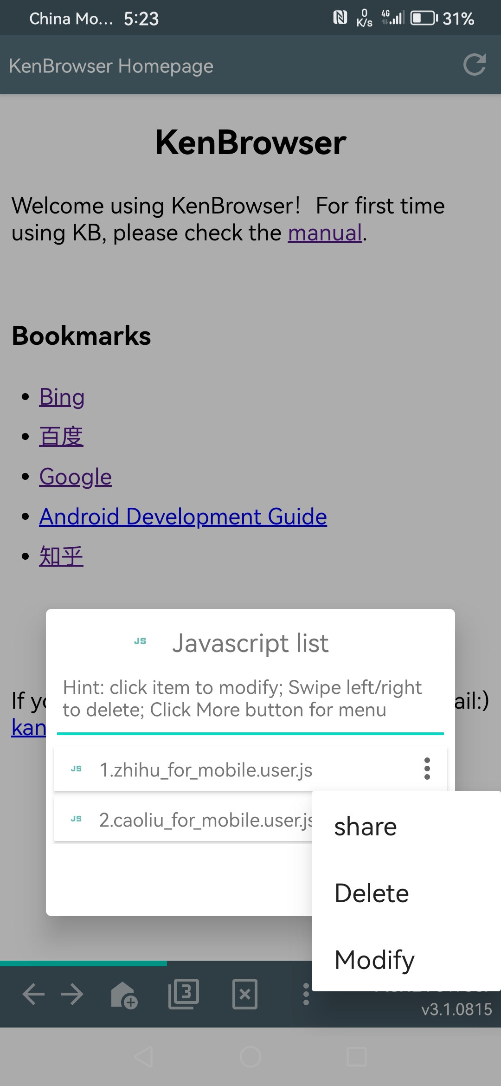
Inject Javascript
Support TamperMonkey scripts
Enhance browser function unlimitedly

